Slide 1
Link budget design
Space Communication Course

Slide 2
OUTLINE
Abstract
Methods
References

Slide 3
Abstract
In this work we designed a link budget between Saturn and Deep Space ground stations on earth located at Canberra, Madrid and Goldstone. We optimized our work to meet the BER criteria and the power limitations.

Slide 4
methods

Slide 5
Analytical Method
BER FOR HGA:
K: 1.57*10 ^-6
X: 3.48*10^-7
S: 8.68^10^-2
BER FOR LGA:
K: 3.4*10^-3
X: 1.6^10^-5
S: 9.2^10^-6

Slide 6
Analytical method
Regarding the receiving antenna at the ground station, we will consider it a 70 meter in diameter, to benefit from the maximum possible gain.
Regarding the high gain transmitting antenna at the satellite, we will consider it 4 meter in diameter antenna.
We have three bands which we study the down links
The ranges were obtained from the 810 paper which are (Frequencies in GHz):
S: 2200 – 2300 X: 8400 – 8500 k: 31.8–32.3
So we chose those frequencies:
S: 2.250 x: 8.450 ka: 32.05
With wave lengths of (wavelengths in meters):
S:0.133 x: 0.036 ka: 9.36*10^-3

Slide 7
Analytical method
R = 1.496*10^9 km
Path loss = depends on frequency
S band: 283 dB
X band: 294.5 dB
K band: 306 dB
Beam loss -3 dB
Link margin -5 dB
Rain -4 dB

Slide 8
Analytical Method
HBR) Noise temperature = KTB = 1.38* 10^-23 * 40 * 10*10^6 = -143 dB
LBR) Noise temperature = KTB = 1.38* 10^-23 * 40 * 2*10^6 = -150 dB

Slide 9
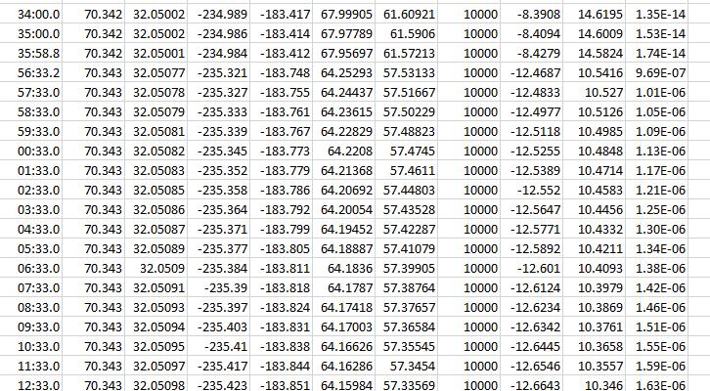
STK method
HGA-K BAND

Slide 10
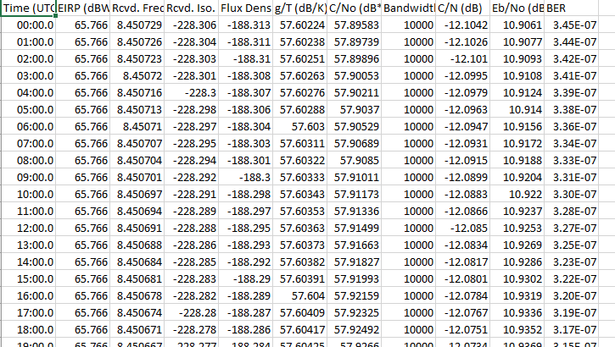
Stk method
HGA) X BAND

Slide 11
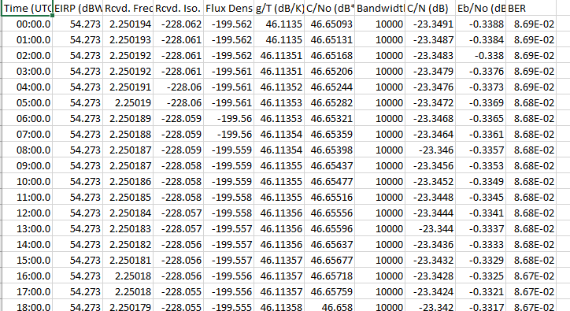
Stk method
HGA) S BAND

Slide 12
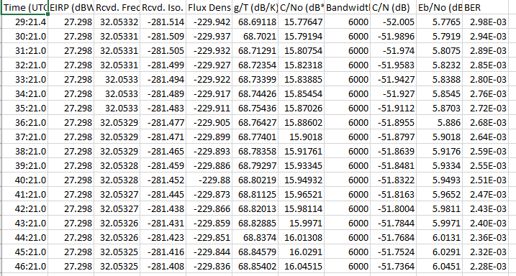
Stk method
LGA) K BAND

Slide 13
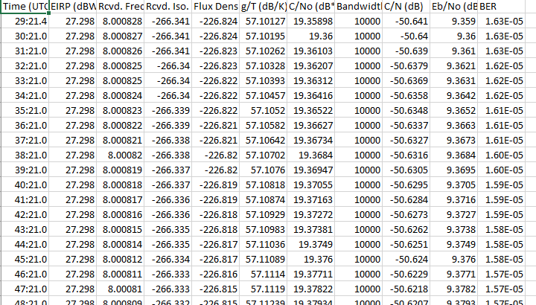
Stk method
LGA) X BAND

Slide 14
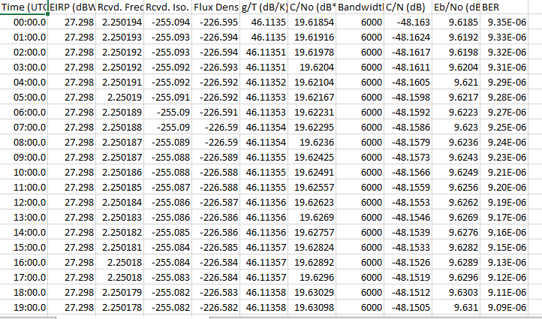
Stk method
LGA) S BAND

Slide 15
refernces
810-005
DESCANSO Design and Performance Summary Series, Article 3 Cassini Orbiter/Huygens Probe Telecommunications

